Slide 1
Overview of DOE funded activities
Patrick Moriarty, Dave Maniaci, Matt Barone
January 20, 2014

Slide 2
Example DOE Project
Eastern United States
Complaints from 12 homes (6 frequently) - 1000 homes within 3 km radius
The annoyance was described as an intermittent "thumping" sound
A "feeling" or "presence" was described… accompanied by sensations of uneasiness and personal disturbance.
Annoyance intermittent when turbines were running
Slower rotor reduced, but not eliminated annoyance
Not atypical reaction to problem wind project today

Slide 3
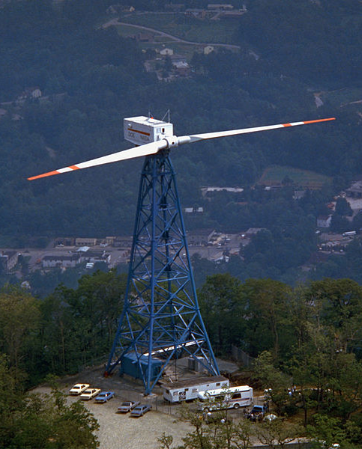
Early History - 1980
MOD-1 turbine, Boone, North Carolina
aka “Thumper”
61 m rotor – 2 MW, GE-NASA Design
Noise focused by terrain and atmosphere +25 dB in some locations
Different than today
Downwind blade tower interaction
High levels of infrasound and low frequency sound – resonance with building frequencies
Airfoils often operating near stall
Noise worse inside than outside
Predecessor – MOD-0 100 kw – noise below ambient

Slide 4
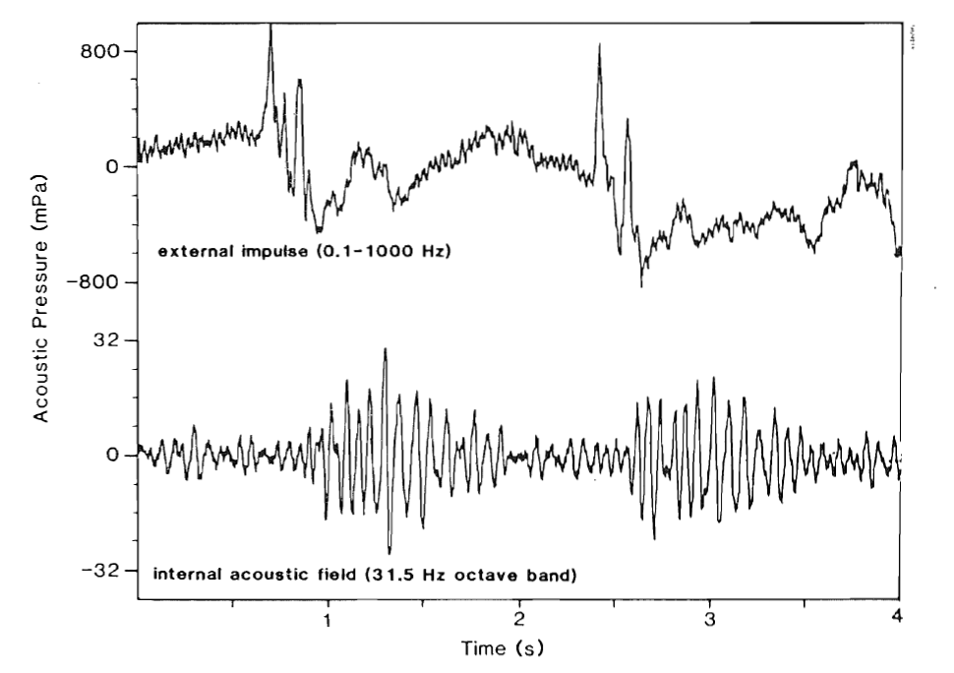
Building Amplification

Slide 5
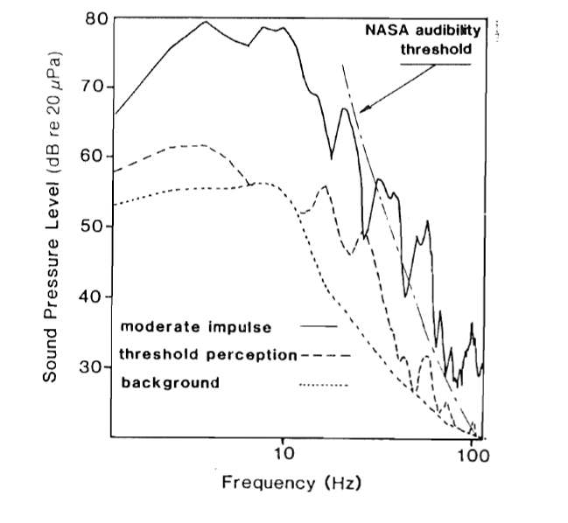
Low frequency/Infrasound

Slide 6

Fast forward to 2013…
The Australian, July 24, 2013
“MODERN wind turbines could cause the same health impacts for nearby residents as an older prototype rejected by the industry because of proven concerns, says the author of a 1987 study that established the link.”
Wind Turbine Syndrome blog, Nina Pierpont, July 6, 2013
“U.S. government has known about Wind Turbine Syndrome since 1987…It’s now 2013, and the government and industry are still pretending they don’t know about this…”

Slide 7
DOE Research 2002-2013
Small Wind
Wind Tunnel Testing of Airfoils – NLR
Utility Scale Wind
Virginia Tech
CFD/CAA Noise Modeling
Penn State University
Florida State University
Semi-Empirical Noise Modeling
Began with Brooks, Pope and Marcolini (1989)
Work with Franco Guidati
NAFNoise and noise module within FAST
Last update July 2005
Acoustic Array Development and measurements – two versions
Small studies
Noise mitigation of blades
Wind plant propagation
Research activities significantly curtailed in 2007 and stopped in 2014
Community Impact
Small effort – mostly hearing concerns through WPA
IEA Task 28 Social Acceptance of Wind Energy Projects
IEC standards testing and measurement standards development ongoing

Slide 8
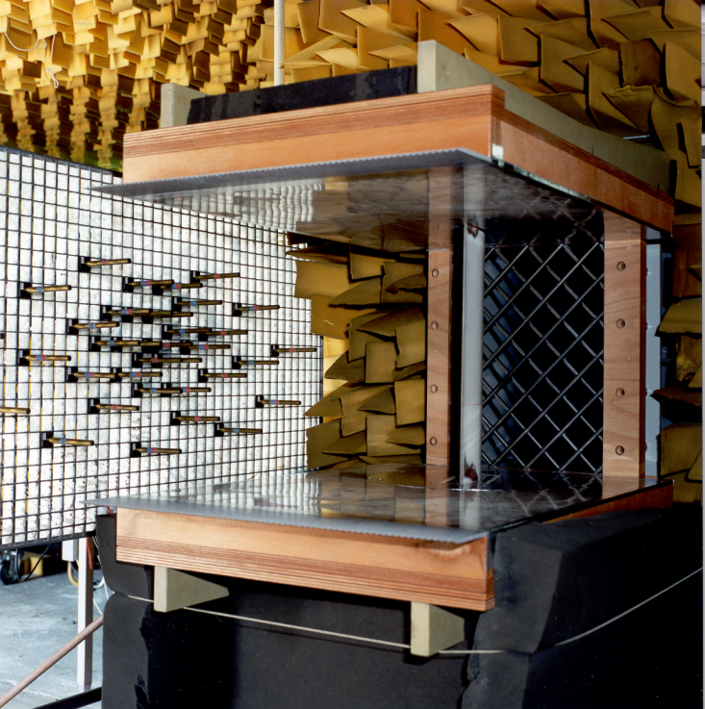
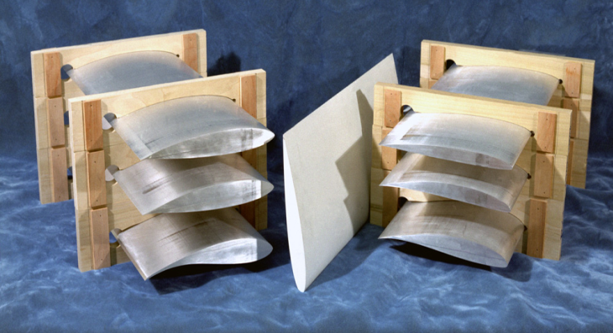
Small Wind Airfoil Testing
Wind tunnel testing
Airfoils
Tip shapes

Slide 9
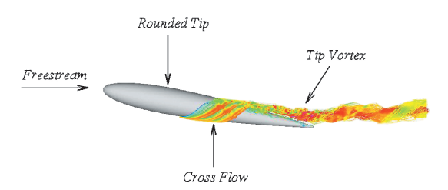
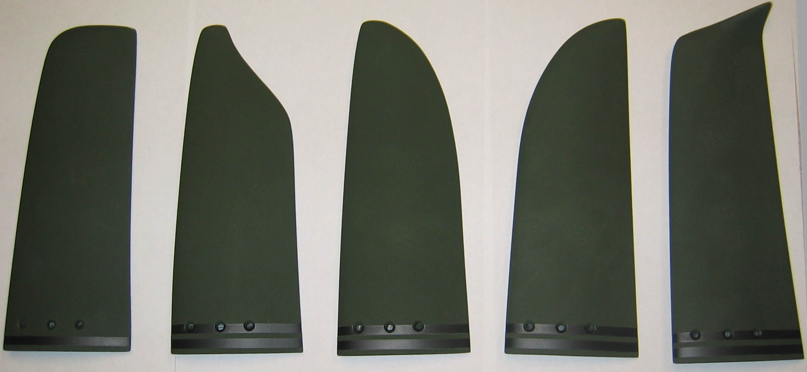
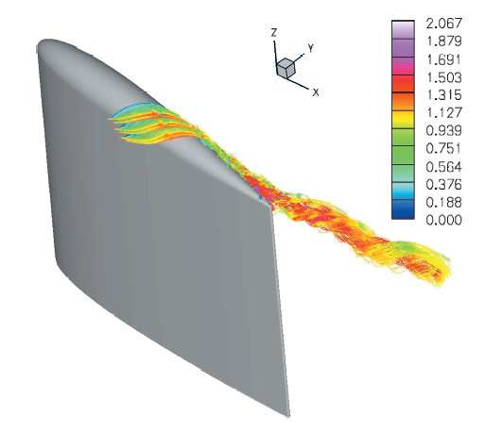
Tip Shape
Modify interaction of tip vortex with blade

Slide 10
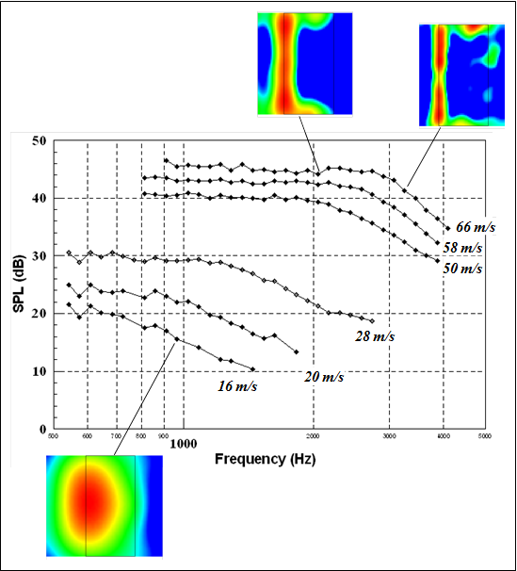
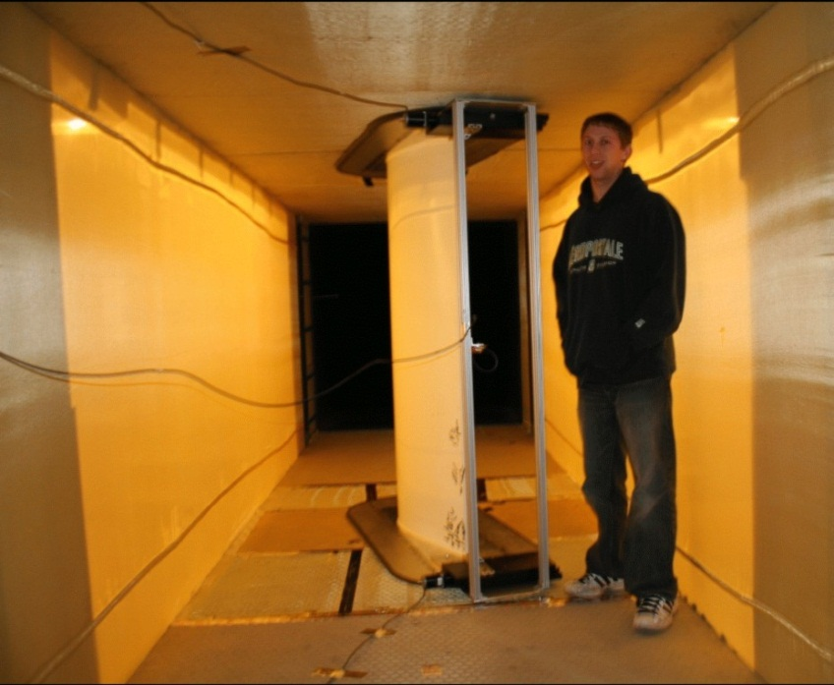
Utility Scale Wind Tunnel Testing

Slide 11
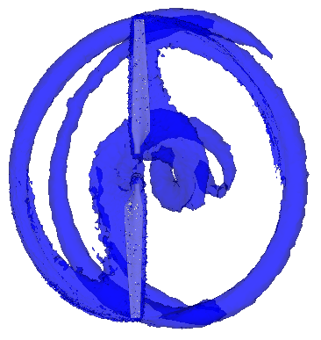
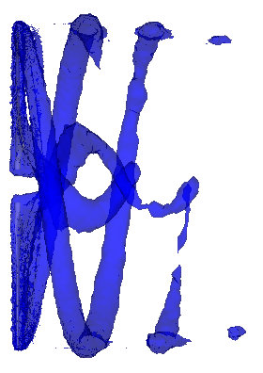
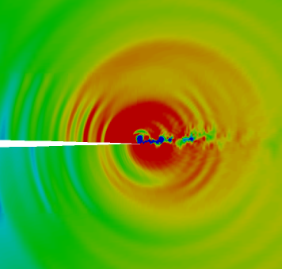
Aeroacoustic Modeling
Semi-empirical methods
Basic
Computational physics
CFD-CAA
Depends on accurate aerodynamic estimates
Not completed according to original plan
Propagation Models
Very basic

Slide 12
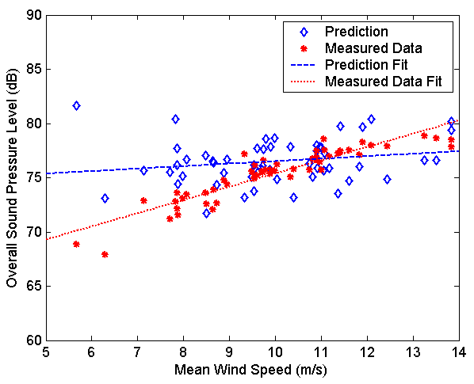
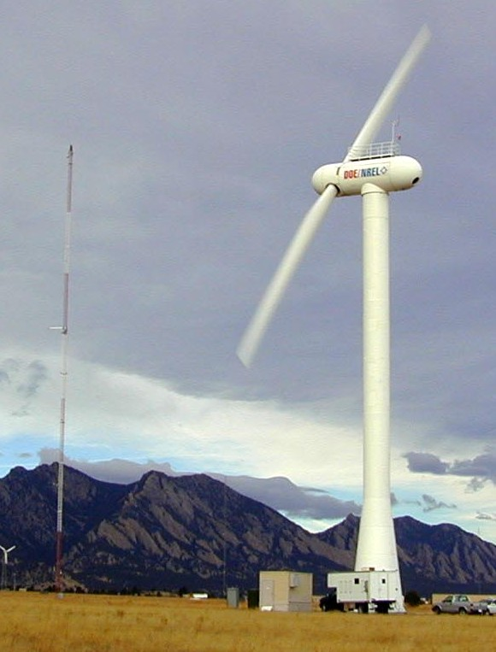
Semi Empirical Code Validation
58 m downwind, δ = 3°

Slide 13
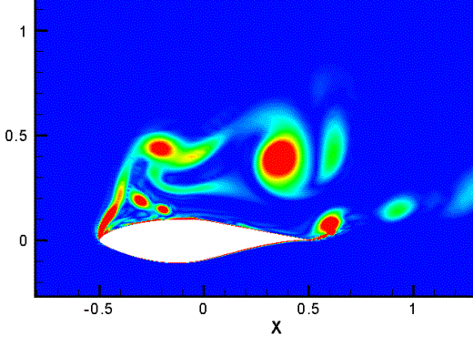
CAA Efforts
Acoustic Spectrum for S809 Airfoil at 30 deg Incidence
(a)
(c)
(b)
(b)
(a)
(c)
Preliminary
Acoustic spectrum at 3 observer locations (0 deg.-upstream; 45 deg; and 90 deg – overhead) 10 chords from an S809 airfoil at 30 deg. incidence, chord = 12 inches; span = 24 inches.

Slide 14
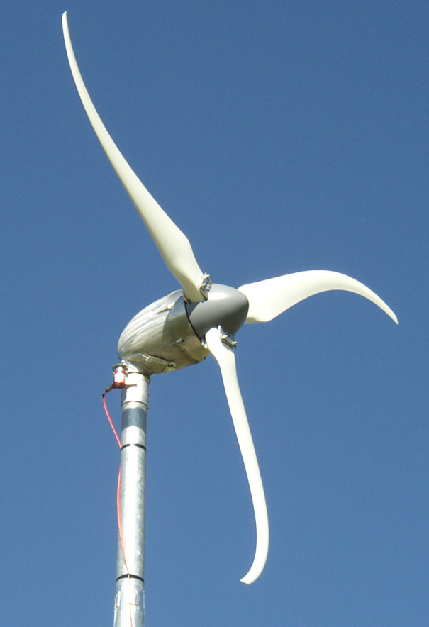
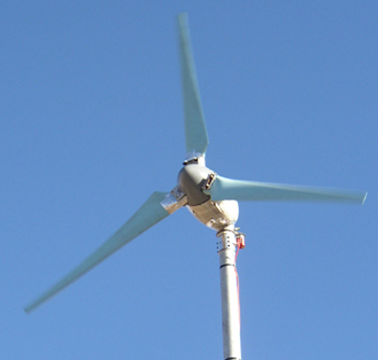
Blade Shape
Spread out blade loading change through tower shadow
Computer fans

Slide 15
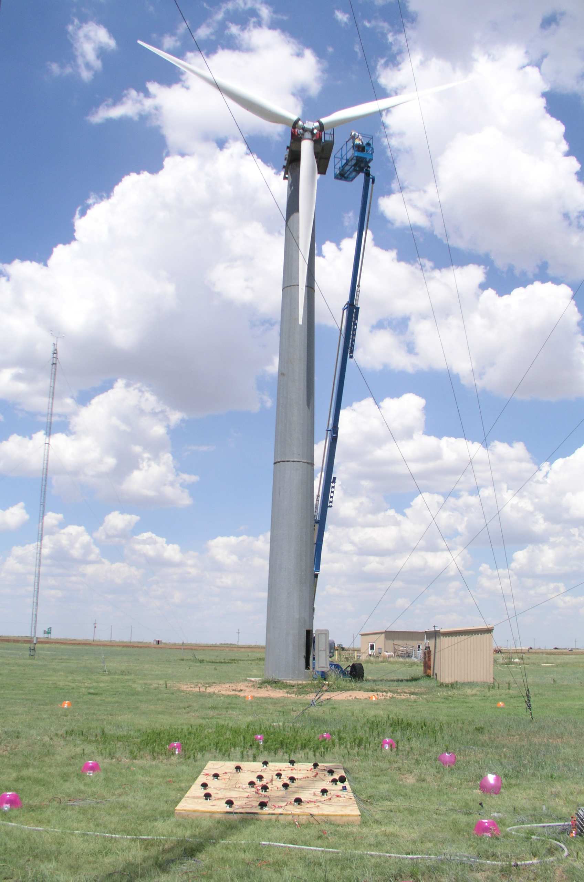
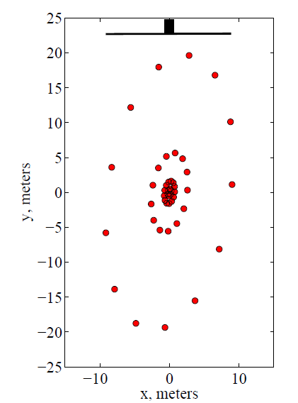
Acoustic Array v 1.0
Acoustic array development and field measurements
32 microphone array
Deployed at NWTC and Sandia Bushland site
Tests on Northwind 100-B and Micon BSDS blades
Validation of modeling tools with acoustic measurements
Notes:
Noise is a big deal: constrains the entire design of the turbine, and a major siting barrier in some cases
Before noise can be mitigated, it must first be understood; to be understood, it must be measured in detail in the field

Slide 16
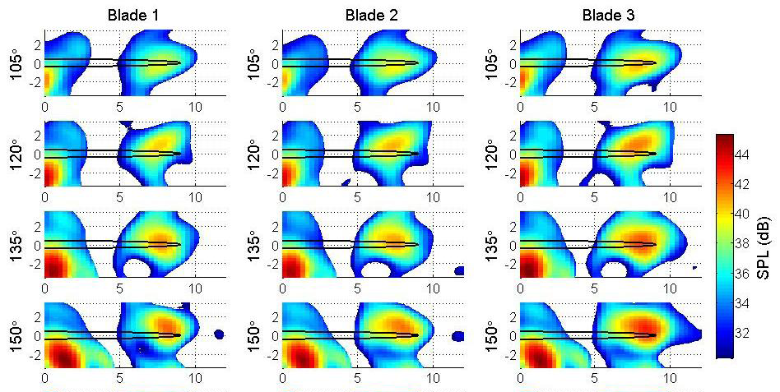
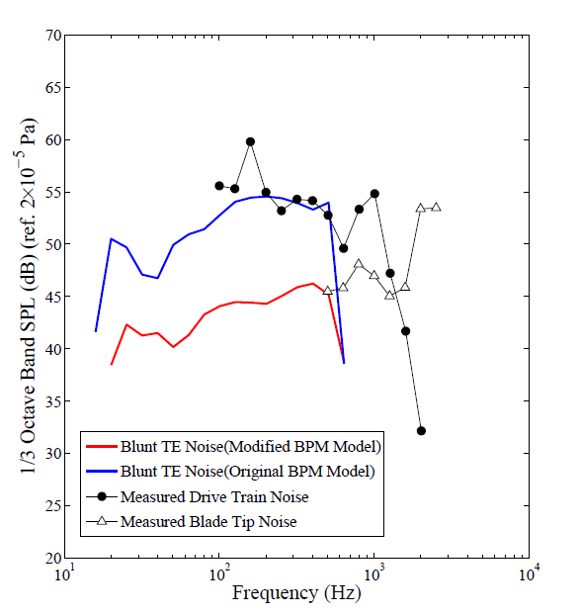
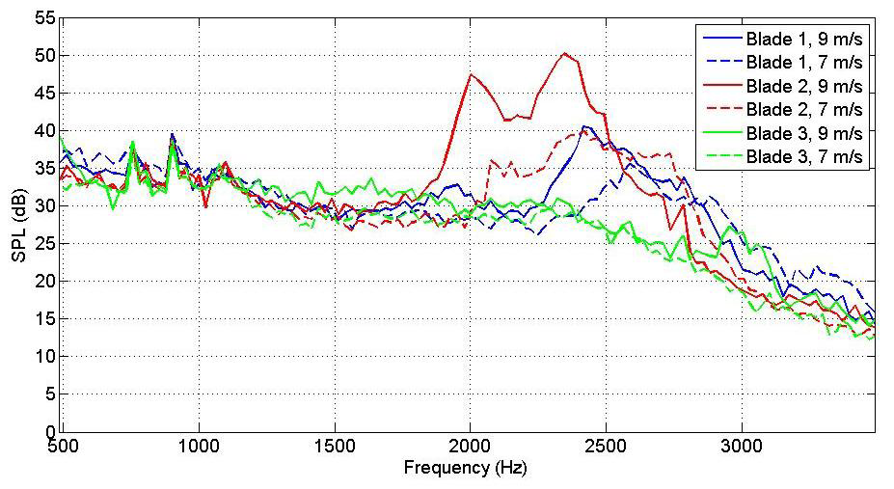
Acoustic Array v 1.0
Field measurements using acoustic array and model comparison
Differentiation of individual blade noise and gearbox noise
Master’s thesis at University of Colorado and EWEC paper
Notes:
- Highlight the ability to identify noise source locations on the blade

Slide 17
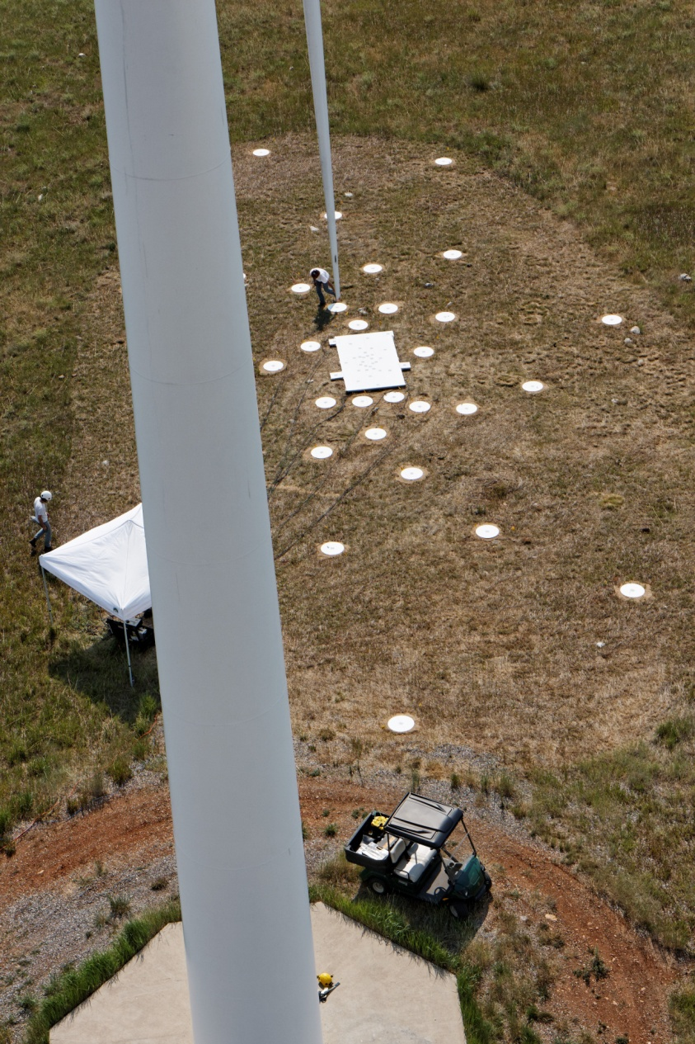
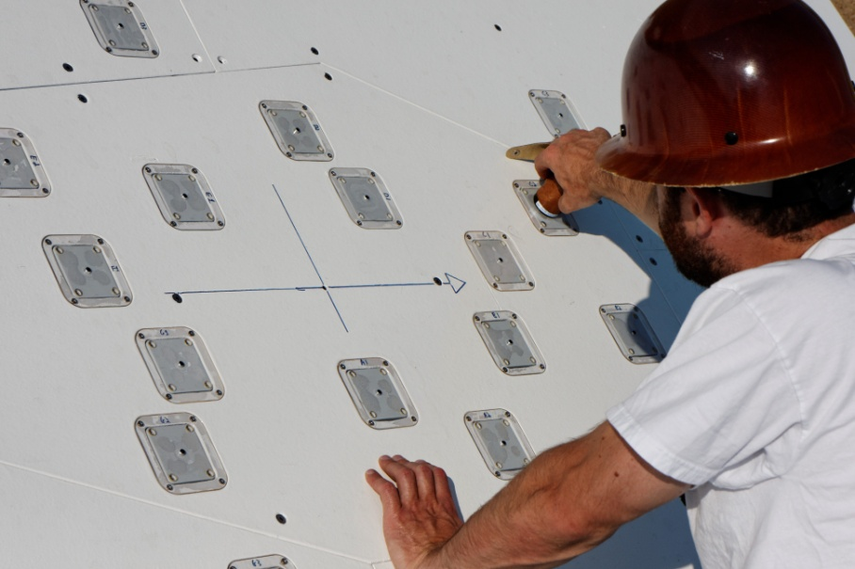
NREL Acoustic Array v 2.0
64 microphones
Logarithmic spiral
Higher signal to noise
More weather resistant
Easily transportable

Slide 18
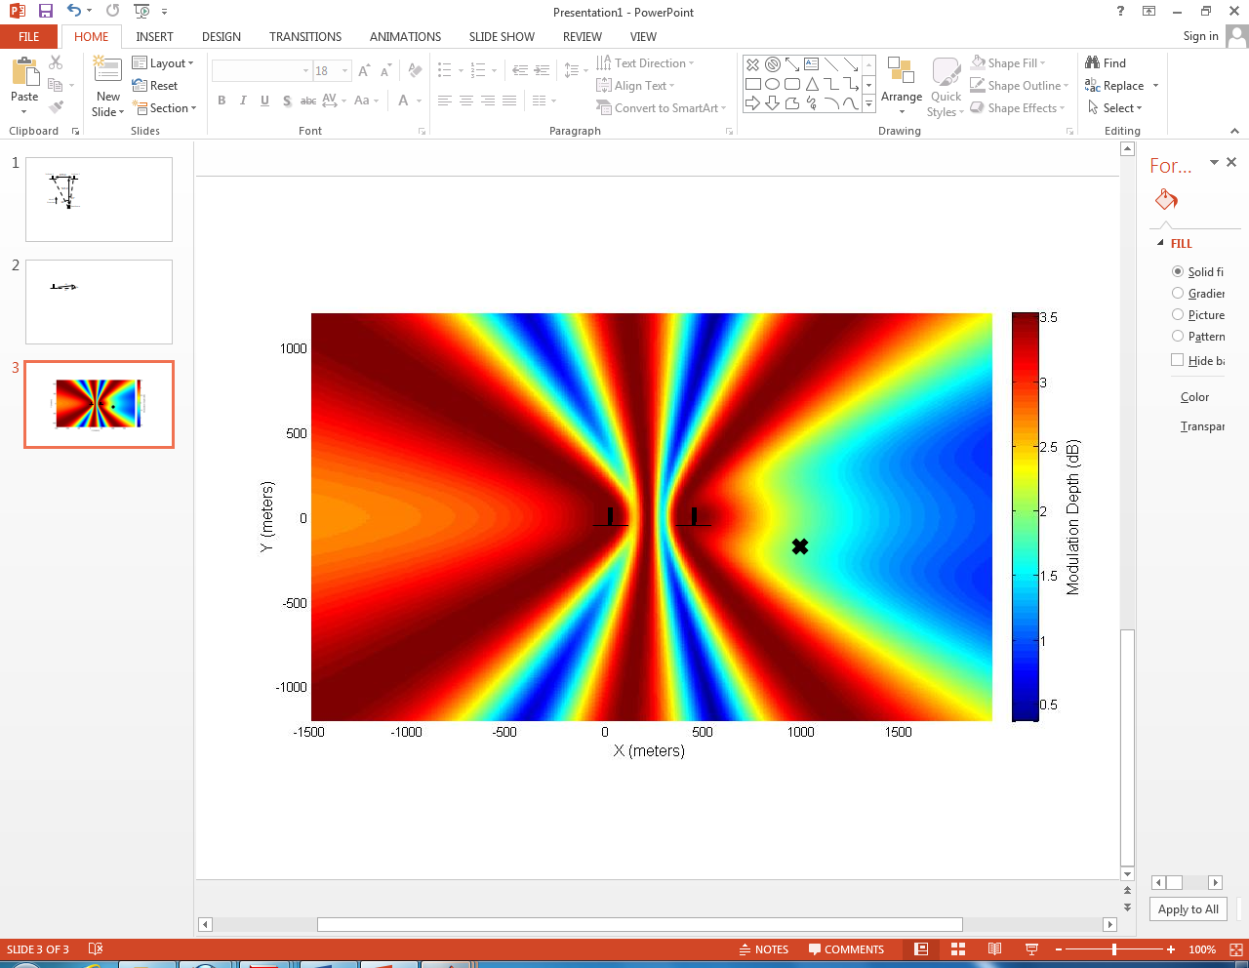
Turbine Interactions

Slide 19
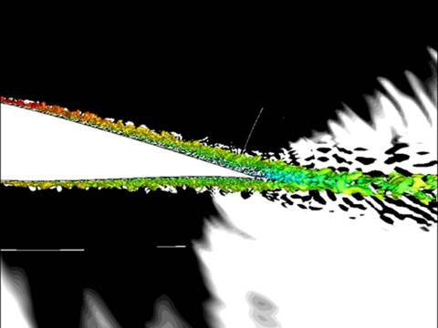
Large Eddy Simulation of Trailing Edge
GE-Stanford-Sandia – usage of DOE HPC facilities

Slide 20
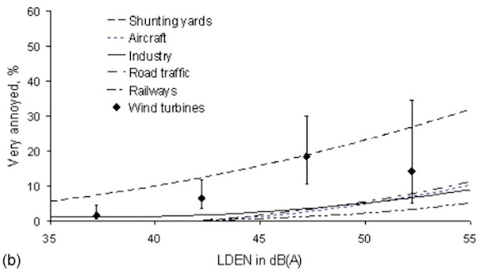
Annoyance

Slide 21
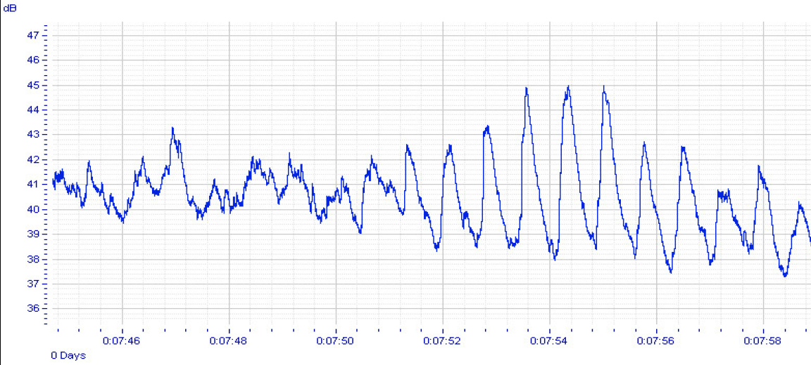
Amplitude Modulation
One theory why wind turbine noise more annoying than other common sources
Di Napoli, 2011

Slide 22
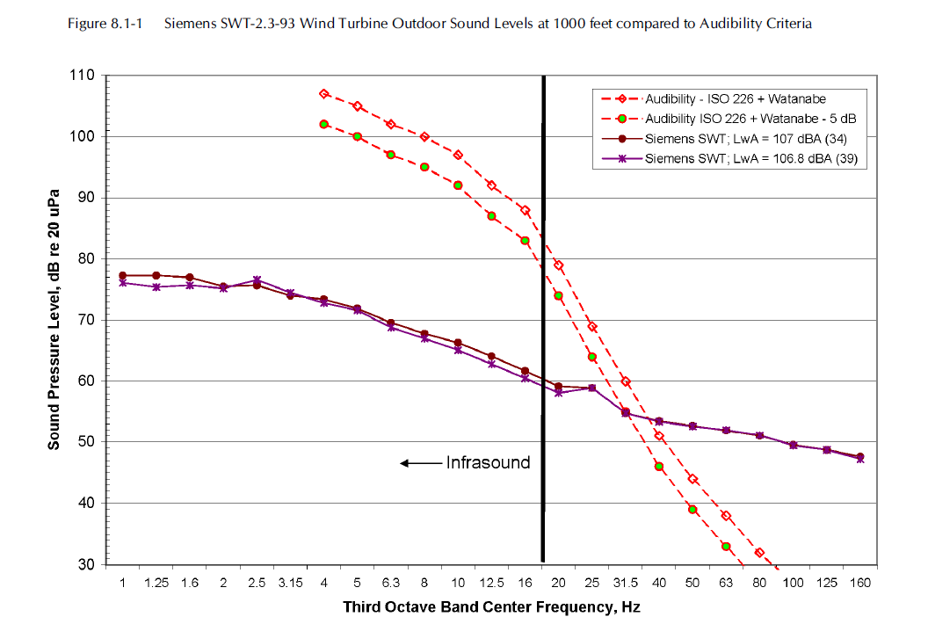
Low Frequency Noise and Infrasound

Slide 23
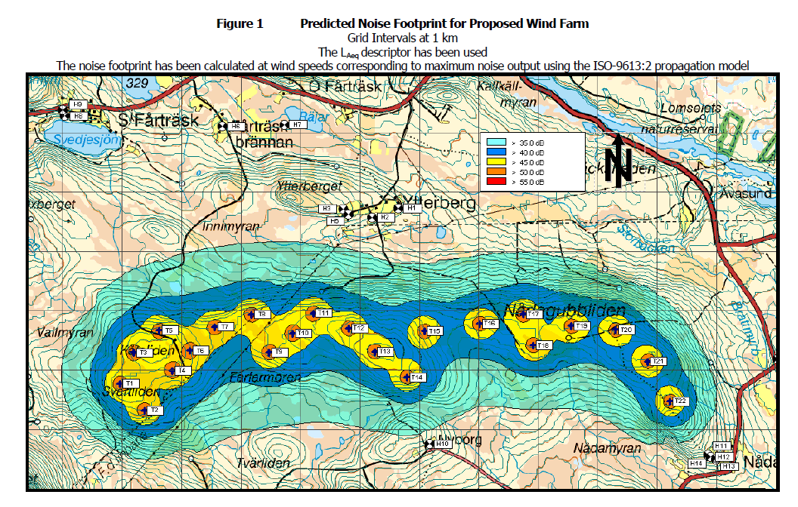
Wind Plant Noise Footprint

